Slide 1
Mathematical Foundations
Elementary Probability Theory

Slide 2
Motivations
Statistical NLP aims to do statistical inference for the field of NL
Statistical inference consists of taking some data (generated in accordance with some unknown probability distribution) and then making some inference about this distribution.

Slide 3
Motivations (Cont)
An example of statistical inference is the task of language modeling (ex how to predict the next word given the previous words)
In order to do this, we need a model of the language.
Probability theory helps us finding such model
Notes:
An example of statistical inference is the task of language modeling
One way to operationalize this is the task of predicting..
If we have a language model we can do this

Slide 4
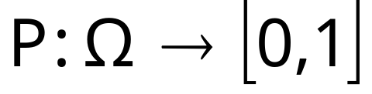
Probability Theory
How likely it is that something will happen
Sample space Ω is listing of all possible outcome of an experiment
Event A is a subset of Ω
Probability function (or distribution)
Notes:
Probability Theory deals with predicting how likely it is that something will happen
Sample space can be continous or discrete. Language applications; discrete

Slide 5
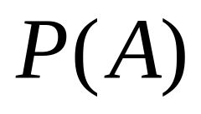
Prior Probability
Prior probability: the probability before we consider any additional knowledge

Slide 6
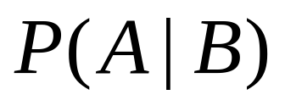
Conditional probability
Sometimes we have partial knowledge about the outcome of an experiment
Conditional (or Posterior) Probability
Suppose we know that event B is true
The probability that A is true given the knowledge about B is expressed by
Notes:
We capture this knowledge through the notion of

Slide 7
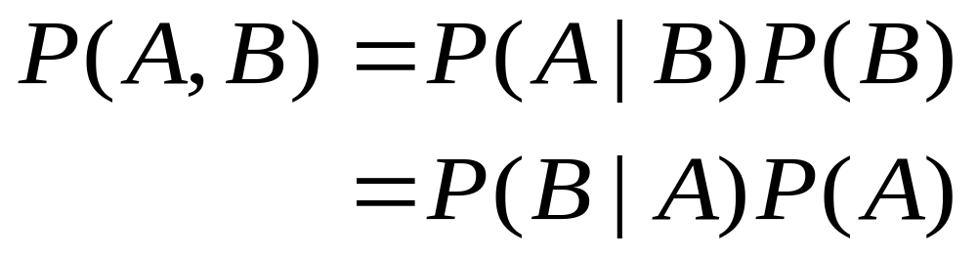
Conditional probability (cont)
Joint probability of A and B.
2-dimensional table with a value in every cell giving the probability of that specific state occurring
Notes:
This rule comes from the fact that for A and B to be true we need B to be true and A to be true given B

Slide 8
Chain Rule
P(A,B) = P(A|B)P(B)
= P(B|A)P(A)
P(A,B,C,D…) = P(A)P(B|A)P(C|A,B)P(D|A,B,C..)
Notes:
Generalization of this rule to multiple events is the chain rule
The Chain Rule is used in many places in Stat NLP such as Markov Model

Slide 9
(Conditional) independence
Two events A e B are independent of each other if
P(A) = P(A|B)
Two events A and B are conditionally independent of each other given C if
P(A|C) = P(A|B,C)
Notes:
A e B independent if P(A,B) = P(A)P(B)

Slide 10
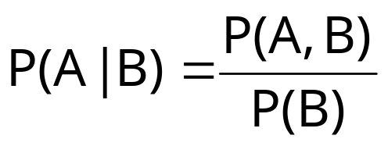
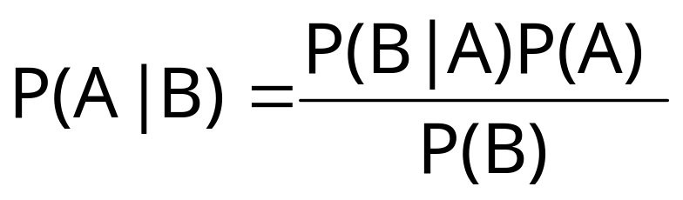
Bayes’ Theorem
Bayes’ Theorem lets us swap the order of dependence between events
We saw that
Bayes’ Theorem:
Notes:
Useful when one quantity is more easy to calculate; trivial consequence of the definitions we saw but it’ s extremely useful

Slide 11
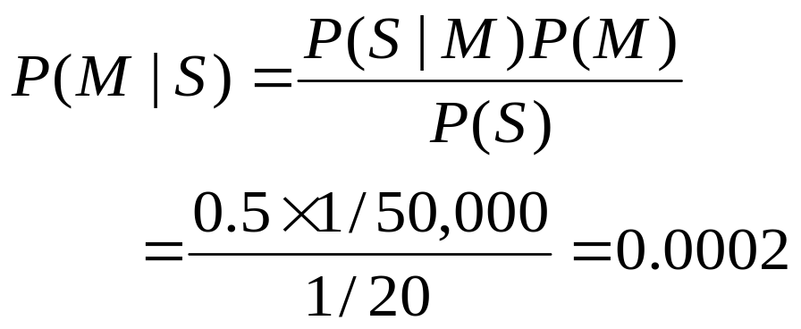
Example
S:stiff neck, M: meningitis
P(S|M) =0.5, P(M) = 1/50,000 P(S)=1/20
I have stiff neck, should I worry?
Notes:
Bayes th tells us why we shouldn’t worry if we get a positive result in a medical test
In a task such as medical diagnosis, we ofte n have cond prob on causal probability and want to derive a diagnosis. Read pag 427 stuart
Diagnosis knowledge P(M|S) is more tenuous than causal knowledge(P(S|M)

Slide 12
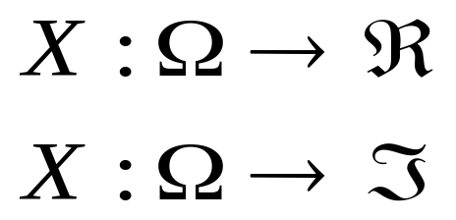
Random Variables
So far, event space that differs with every problem we look at
Random variables (RV) X allow us to talk about the probabilities of numerical values that are related to the event space
Notes:
Random Variable if a function from the sample space to the real number for continuous RV.
Because a RV has a numerical range, we can often do math more easily by working with the values of a RV rather then directly with events and we can define a probability for a random V
Or to the integer numbers for discrete RV

Slide 13
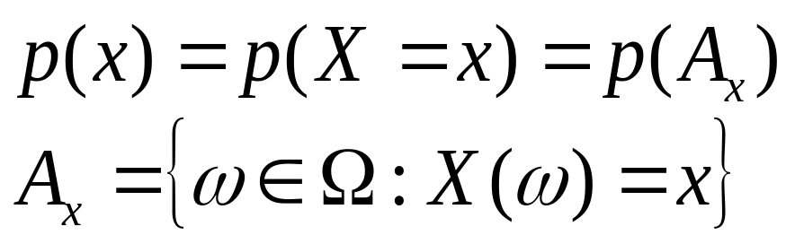
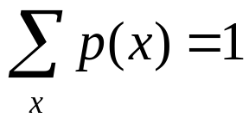

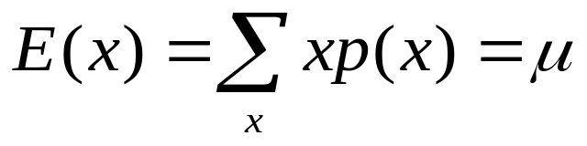
Expectation
The Expectation is the mean or average of a RV

Slide 14
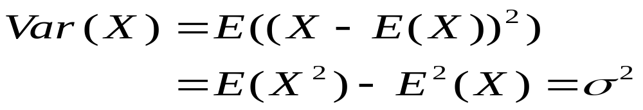
Variance
The variance of a RV is a measure of whether the values of the RV tend to be consistent over trials or to vary a lot
σ is the standard deviation

Slide 15
Back to the Language Model
In general, for language events, P is unknown
We need to estimate P, (or model M of the language)
We’ll do this by looking at evidence about what P must be based on a sample of data

Slide 16
Estimation of P
Frequentist statistics
Bayesian statistics
Notes:
2 different approaches, 2 different philosphies

Slide 17
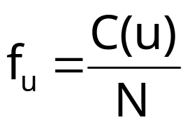

Frequentist Statistics
Relative frequency: proportion of times an outcome u occurs
C(u) is the number of times u occurs in N trials
For the relative frequency tends to stabilize around some number: probability estimates
Notes:
That this number exists provides a basis for letting us calculate probability estimates

Slide 18
Frequentist Statistics (cont)
Two different approach:
  Parametric
  Non-parametric (distribution free)

Slide 19
Parametric Methods
Assume that some phenomenon in language is acceptably modeled by one of the well-known family of distributions (such binomial, normal)
We have an explicit probabilistic model of the process by which the data was generated, and determining a particular probability distribution within the family requires only the specification of a few parameters (less training data)
Notes:
training data id the data needed to find out the parameters
But sometimes we can’t make this assumption

Slide 20
Non-Parametric Methods
No assumption about the underlying distribution of the data
For ex, simply estimate P empirically by counting a large number of random events is a distribution-free method
Less prior information, more training data needed
Notes:
The disadvantage is that we give our system less prior information of how the data was generated, so a much bigger training set is needed to compensate for this
These methods are used in automatic classification when the underlying distribution of the data is unknown (neirest t neighbor classification)

Slide 21
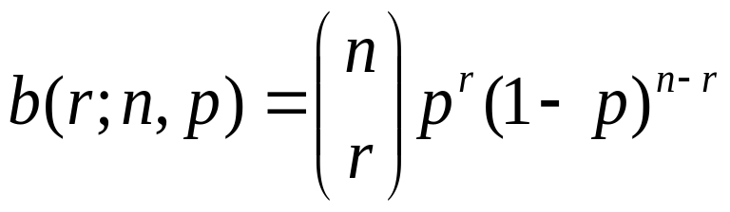
Binomial Distribution (Parametric)
Series of trials with only two outcomes, each trial being independent from all the others
Number r of successes out of n trials given that the probability of success in any trial is p:
Notes:
Es tossing a coin. When looking at linguistic corpora one has never complete independence from one sentence to the other: approximation
Use BD any time one is counting whether something is present or absent, has a certain property or not (assuming independence)
BD is actually quite common in SNLP: ex: look throug a corpus to find out the
Estimate of the percent of sentence that have a certain word in them
Or finding out how commonly a verb is used as transitive or intransitive
(count the times)
Numb of different possibility for choosing r objects out of N, order is not important
=n!/(n-r)!r!
Expect of np, variance on np(1-p)

Slide 22
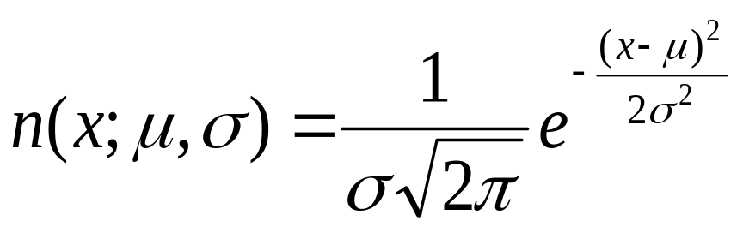
Normal (Gaussian) Distribution (Parametric)
Continuous
Two parameters: mean μ and standard deviation σ
Used in clustering
Notes:
For example for measurements of heights, lenghts, etc
For μ =0 and σ=1 STANDARD NORMAL DISTRIBUTION
Clustering+chapter 14

Slide 23

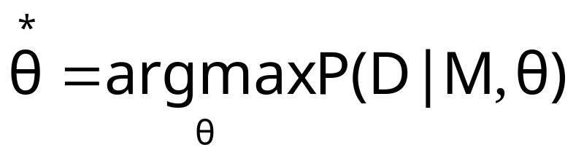
Frequentist Statistics
D: data
M: model (distribution P)
Θ: parameters (es μ, σ)
For M fixed: Maximum likelihood estimate: choose such that

Slide 24

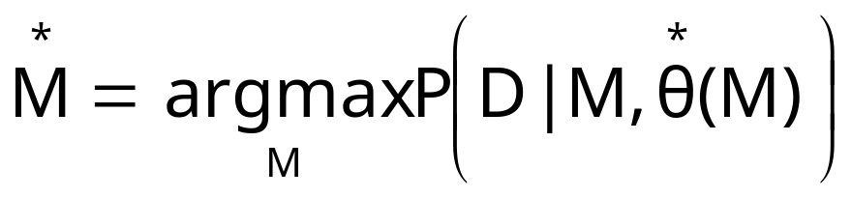
Frequentist Statistics
Model selection, by comparing the maximum likelihood: choose such that
Notes:
Frequentist also do medel selection:
For them probability espresses something about the world no belief!

Slide 25
Estimation of P
Frequentist statistics
  Parametric methods
    Standard distributions:
    Binomial distribution (discrete)
    Normal (Gaussian) distribution (continuous)
      Maximum likelihood
  Non-parametric methods
Bayesian statistics
Notes:
Distribution is a family of probability functions;
Parameters are the number that define the different members of the family

Slide 26
Bayesian Statistics
Bayesian statistics measures degrees of belief
Degrees are calculated by starting with prior beliefs and updating them in face of the evidence, using Bayes theorem
Notes:
From a frequentist point of view if I toss a coin 10 times and I get head 8 tiems, I would
Conclude that P(head) = 8/10: Maximum likelihood estimate
But if I nothing wrong with coin, 8/10 is hardo to believe: long run = ½
I have a prior belief

Slide 27
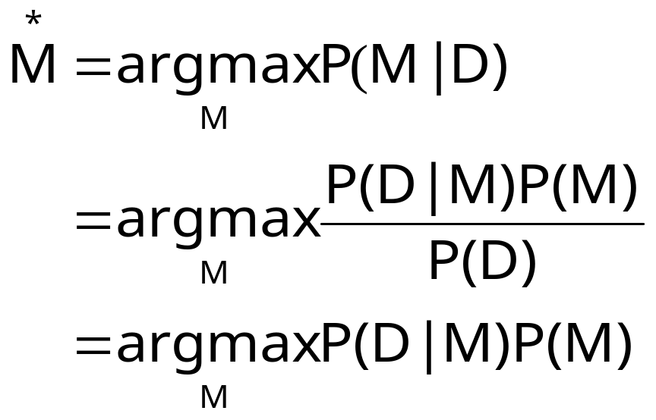

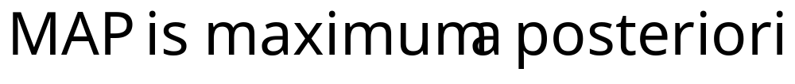
Bayesian Statistics (cont)
Notes:
Note here P(M): prior on the model: Bayesian have prior beliefs of how likely the models are

Slide 28
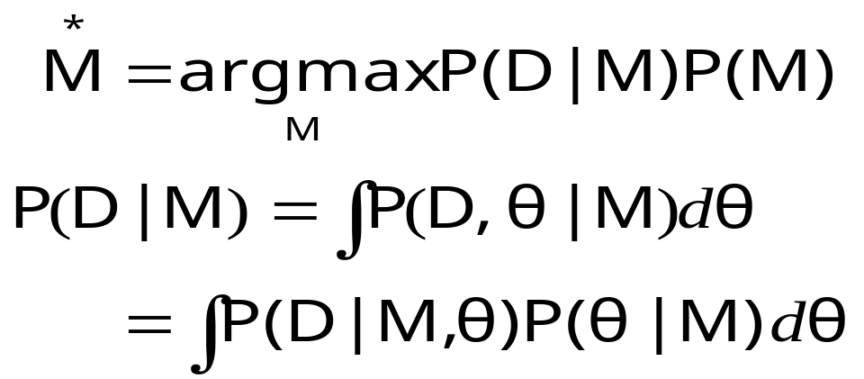
Bayesian Statistics (cont)
M is the distribution; for fully describing the model, I need both the distribution M and the parameters θ
Notes:
Marginal likelihood IMPORTANT!!

Slide 29
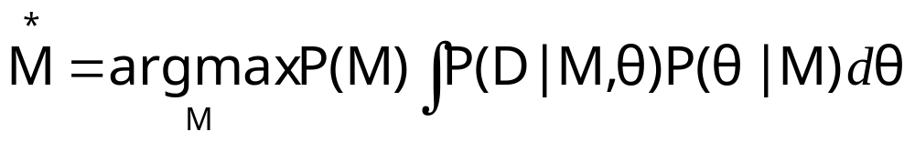
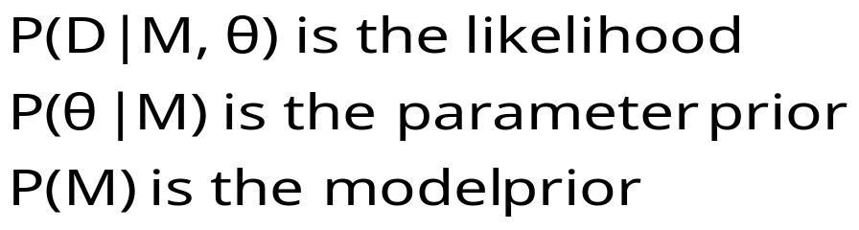
Frequentist vs. Bayesian
Bayesian
Frequentist
Notes:
Main point is that frequentists don’t use the parameter prior P(theta|M) because
The parameter esists, it’s not a probability, or belief.
Freq probability is to express things about the world, no belief

Slide 30
Bayesian Updating
How to update P(M)?
We start with a priori probability distribution P(M), and when a new datum comes in, we can update our beliefs by calculating the posterior probability P(M|D). This then becomes the new prior and the process repeats on each new datum

Slide 31
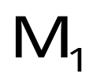

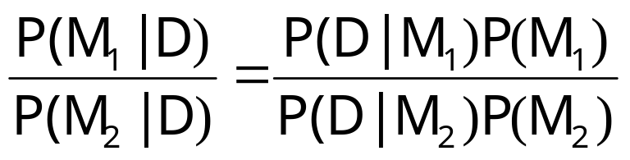
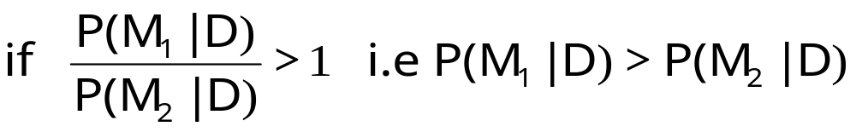
Bayesian Decision Theory
Suppose we have 2 models and ; we want to evaluate which model better explains some new data.
is the most likely model, otherwise

Slide 32
Essential Information Theory
Developed by Shannon in the 40s
Maximizing the amount of information that can be transmitted over an imperfect communication channel
Data compression (entropy)
Transmission rate (channel capacity)
Notes:
Shannon was interested in the problem of
Shannon wanted to determine theoretical maxima for !)

Slide 33
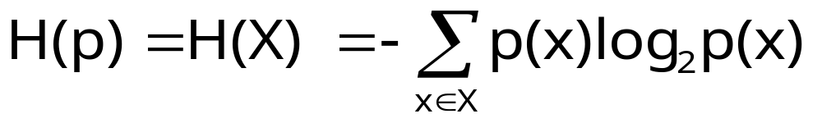
Entropy
X: discrete RV, p(X)
Entropy (or self-information)
Entropy measures the amount of information in a RV; it’s the average length of the message needed to transmit an outcome of that variable using the optimal code
Notes:
using the optimal code = the entropy will be the minimum

Slide 34
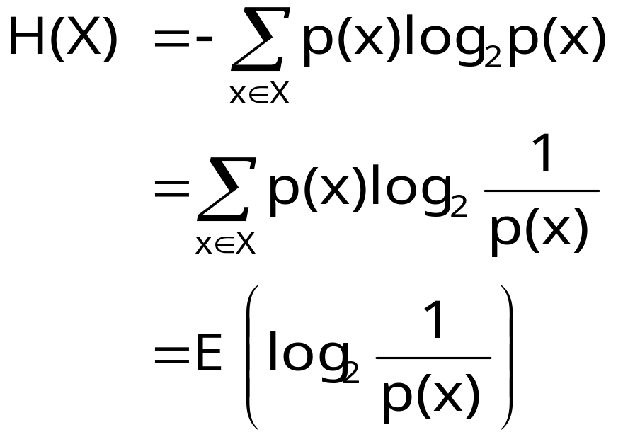
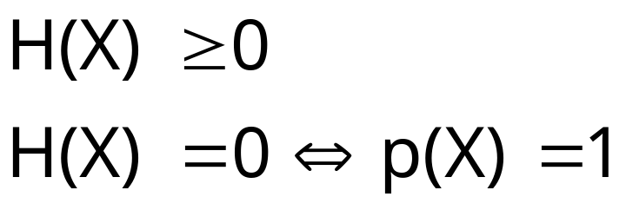
Entropy (cont)
i.e when the value of X
is determinate, hence
providing no new
information
Notes:
H is a weighted average for log(p(X) where the weighting depends on the probability of each x
H INCREASES WITH MESSAGE LENGTH

Slide 35
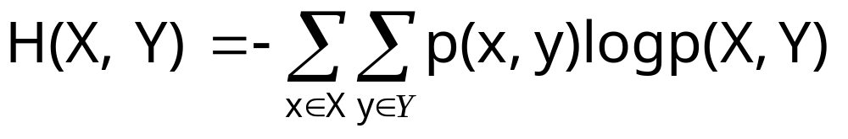
Joint Entropy
The joint entropy of 2 RV X,Y is the amount of the information needed on average to specify both their values

Slide 36
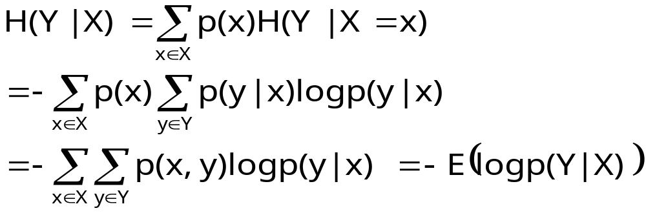
Conditional Entropy
The conditional entropy of a RV Y given another X, expresses how much extra information one still needs to supply on average to communicate Y given that the other party knows X

Slide 37
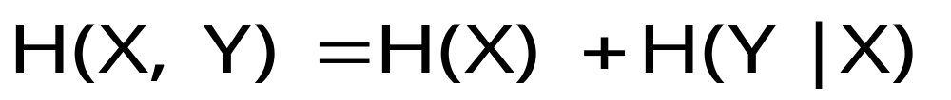
Chain Rule

Slide 38
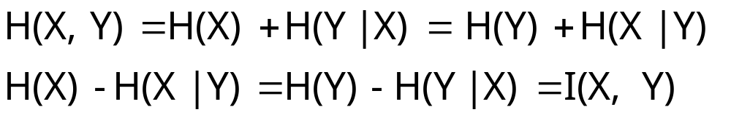
Mutual Information
I(X,Y) is the mutual information between X and Y. It is the reduction of uncertainty of one RV due to knowing about the other, or the amount of information one RV contains about the other

Slide 39
Mutual Information (cont)
I is 0 only when X,Y are independent: H(X|Y)=H(X)
H(X)=H(X)-H(X|X)=I(X,X) Entropy is the self-information
Notes:
For 2 dependent variables, I grows not only with the degree of their dependence but only with their entropy
H(X) = I(X<X)
This explain also how mutual information between 2 totally dependent variables is not constant but depends on their entropy

Slide 40
Entropy and Linguistics
Entropy is measure of uncertainty. The more we know about something the lower the entropy.
If a language model captures more of the structure of the language, then the entropy should be lower.
We can use entropy as a measure of the quality of our models
Notes:
2) Means better code; optimal code entropy minimum!!
Entropy of the language Exists in the world; but we don’t know it
(we don’t know P); we can only look for better code hoping to lower the
Entropy

Slide 41
Entropy and Linguistics
H: entropy of language; we don’t know p(X); so..?
Suppose our model of the language is q(X)
How good estimate of p(X) is q(X)?

Slide 42
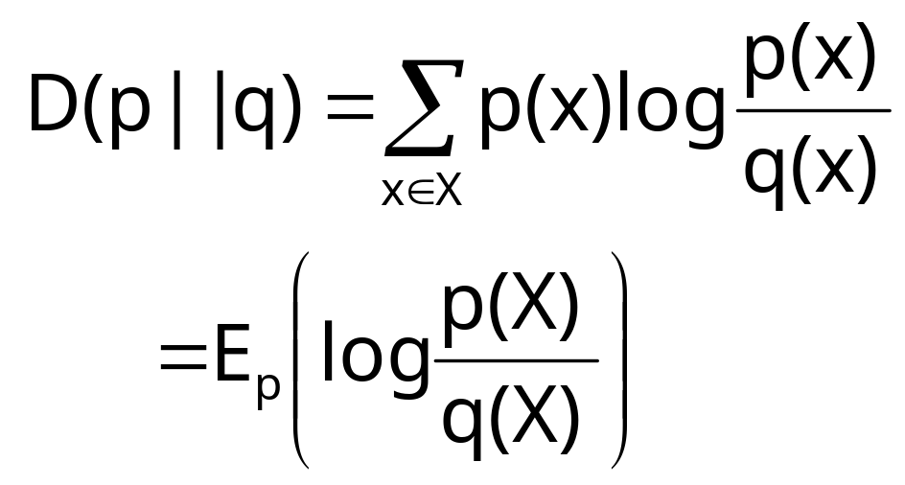
Entropy and Linguistic
Kullback-Leibler Divergence
Relative entropy or KL (Kullback-Leibler) divergence

Slide 43
Entropy and Linguistic
Measure of how different two probability distributions are
Average number of bits that are wasted by encoding events from a distribution p with a code based on a not-quite right distribution q
Goal: minimize relative entropy D(p||q) to have a probabilistic model as accurate as possible
Notes:
Measure of how different two probability distribution (OVER THE SAME EVENT SPACE) are
We cannot actually do this because we still don’t know p: tricks, use of another quantity Cross entropy, approximation see pag 75

Slide 44
The Noisy Channel Model
The aim is to optimize in terms of throughput and accuracy the communication of messages in the presence of noise in the channel
Duality between compression (achieved by removing all redundancy) and transmission accuracy (achieved by adding controlled redundancy so that the input can be recovered in the presence of noise)

Slide 45
The Noisy Channel Model
Goal: encode the message in such a way that it occupies minimal space while still containing enough redundancy to be able to detect and correct errors
W
X
Y
W*
Channel
p(y|x)
encoder
decoder
message
input to
channel
Attempt to
reconstruct
message based
on output
Output from
channel
Notes:
P is a property of the channel; I have control over p(X): design of the code

Slide 46
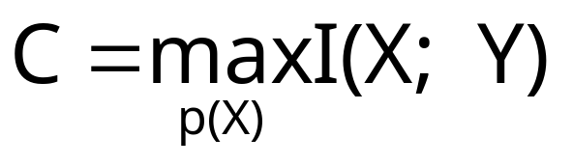
The Noisy Channel Model
Channel capacity: rate at which one can transmit information through the channel with an arbitrary low probability of being unable to recover the input from the output
We reach a channel capacity if we manage to design an input code X whose distribution p(X) maximizes I between input and output
Notes:
C is a property of the channel:
Control over p(X): we can design a code P appropriate for the channel that will transmit information at a rate that is optimal or very close to optimal

Slide 47

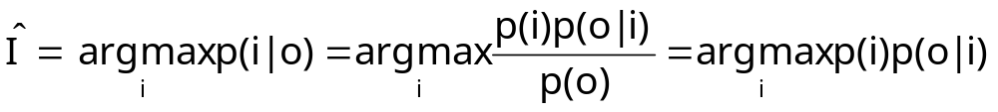
Linguistics and the Noisy Channel Model
In linguistic we can’t control the encoding phase. We want to decode the output to give the most likely input.
I
O
Noisy Channel
p(o|I)
decoder
Notes:
Many problems in SNLP can be constructed as an attempt to determine the most likely
Output given a certain input

Slide 48
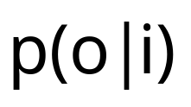
The noisy Channel Model
p(i) is the language model and is the channel probability
Ex: Machine translation, optical character recognition, speech recognition
Notes:
Se pag 71 table

